Slide 1

CS 560: Software Engineering
People Management and Team Organization
Dr. Mohammed Ayoub Alaoui Mhamdi
Bishop's University
Sherbrooke, Qc, Canada
malaoui@ubishops.ca
Notes:
© SE, Introduction, Hans van Vliet
LEARNING OBJECTIVES
To be aware of the importance of people issues in software development
To know of different ways to organize work
To know of major types of management styles
To appreciate different ways to organize a software development team

Slide 2

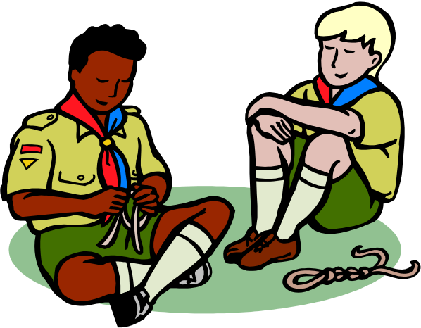
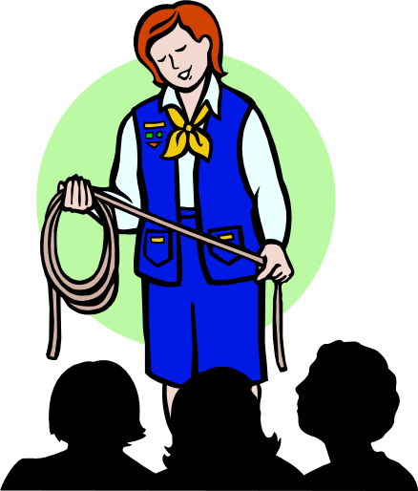
Different ways to organize people

Slide 3
People management
People have different goals
People and productivity
Group processes
Coordination of work
Importance of informal communication
Notes:
Software development involves teamwork. The members of the team have to coordinate their work, communicate their decisions, etc. For a small project, the team will consist of up to a few individuals. As the size of the project increases, so will the team. Large teams are difficult to manage, though. Coordinating the work of a large team is difficult. Communication between team members tends to increase exponentially with the size of the team.
© SE, Introduction, Hans van Vliet

Slide 4
Mintzberg’s coordination mechanisms
Simple: direct supervision
Machine bureaucracy: standardization of work processes
Divisionalized form: standardization of work products
Professional bureaucracy: standardization of worker skills
Adhocracy: mutual adjustment
Notes:
© SE, People, Hans van Vliet
Simple: few bosses, many workers. The bosses use direct supervision. Often in small organizations.
Machine bureaucracy: work is completely specified. Assembly lines. Little training, much specialization.
Divisionalized form: each division has freedom to reach goals. Control is by regularly measuring the performance of the division.
Professional bureaucracy: skilled professionals are given autonomy, as in hospitals.
Adhocracy: a group of colleagues has to carry out a complex job.
These are obviously extremes.

Slide 5
External and Internal forces
Example context: a complex software development project in a new, not yet explored area, within a government agency
External force: the bureaucratic context is likely to want to push a bureaucratic type of organization, with bosses, and hierarchical decision procedures
Internal force: the project really requires a more democratic, consensus-based type of organization
Notes:
© SE, People, Hans van Vliet
And these forces then easily clash.
See also the London Ambulance Service debacle.

Slide 6
Management Styles
Two dimensions in managing people:
Relation directedness This concerns attention to an individual and his relationship to other individuals within the organization.
Task directedness This concerns attention to the results to be achieved and the way in which these results must be achieved.
Notes:
Both relation and task directedness may be high or low. This leads to four basic combinations, as depicted in figure 5.1.Obviously, these combinations correspond to extreme orientations. For each dimension, there is a whole spectrum of possibilities.
© SE, Introduction, Hans van Vliet

Slide 7
Reddin’s management styles
task directedness
low
high
separation
style
commitment
style
low
relation
directedness
relation
style
integration
style
high
Notes:
© SE, People, Hans van Vliet
Separation style: suited for routine work; efficiency is central theme. Management is bureaucratic. Looks like Mintzberg’s coordination through standardization of work processes style
Relation style: effective where people have to be motivated. Tasks are bound to individuals. Work is innovative. Looks like mutual adjustment scheme
Commitment style: effective when work is done under pressure. Decisions making is not done in meetings; decisions are implied by shared vision of the team. Fits professional bureaucracy.
Integration style: fits when result is uncertain. Work is explorative. Manager has to stimulate and motivate. Looks like mutual adjustment too.

Slide 8
Focus
In both these schemes, we look from the manager to the team.
We may also take the opposite position, and consider the relation and task maturity of individual team members.
The manager should align his dealings with team members with their maturity.
Notes:
© SE, People, Hans van Vliet
For example, a fresh graduate may have high task maturity and low relation maturity. His introduction into a skilled team may then warrant some guidance.

Slide 9
Team Organization
Hierarchical organization
Matrix organization
Chief programmer team
SWAT team
Agile team/Extreme Programming (XP)
Open Source Develoment
Notes:
© SE, People, Hans van Vliet
The first two (hierarchical and matrix) are traditional team organizations, and not specific to software development.
The latter three are quite specific to s.d.
Chief programmer team was fashionable for a while; originated within IBM. The chief programmer is the first amongst his pals.
SWAT = Skilled Team with Advanced Tools. Goes with RAD -- Rapid Application Development. The team quickly builds a series of prototypes.
Open Structured Team is from Constantine. Looks like chief programmer team, with a few more rules.
XP: Extreme Programming, the latest fad.

Slide 10

Hierarchical team
Notes:
critical point in any hierarchical organization is the distance between the top and the bottom of the hierarchical pyramid. The ‘real’ work is generally done at the lower levels of this pyramid. The people at these lower levels generally possess the real knowledge of the application. The higher one rises in the hierarchy, the less specific the knowledge becomes
© SE, Introduction, Hans van Vliet

Slide 11
Hierarchical team
bottom: we have severe troubles in implementing module X;
level 1: there are some problems with module X;
level 2: progress is steady, I do not foresee any real problems;
top: everything proceeds according to our plan.
Notes:
© SE, Introduction, Hans van Vliet

Slide 12
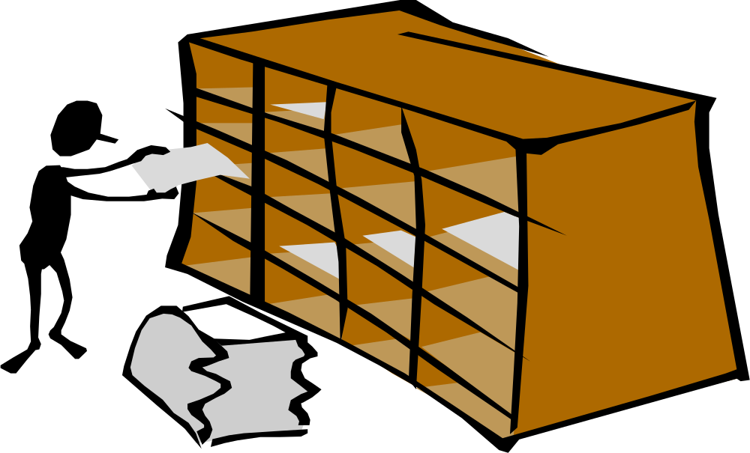
Matrix organization
Notes:
People from different departments are then allocated to a software development project, possibly part-time. In this type of organization it is sometimes difficult to control progress. An employee has to satisfy several bosses and may have the tendency to play off one boss against another.
© SE, Introduction, Hans van Vliet

Slide 13
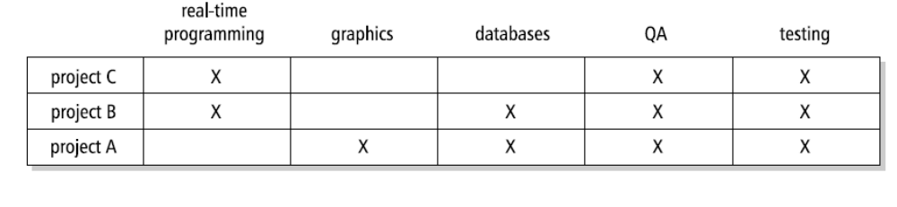
Matrix organization
Notes:
People from different departments are then allocated to a software development project, possibly part-time. In this type of organization it is sometimes difficult to control progress. An employee has to satisfy several bosses and may have the tendency to play off one boss against another.
© SE, Introduction, Hans van Vliet

Slide 14


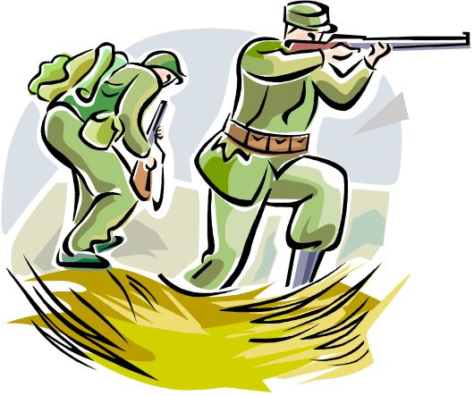
Chief programmer team

Slide 15
Chief programmer team
The kernel of such a team consists of three people.
  The chief programmer is team leader. He takes care of the design and implements key parts of the system.
  The chief programmer has an assistant who can stand in for the chief programmer, if needed.
  Thirdly, a librarian takes care of the administration and documentation.
  Besides these three people, an additional (small) number of experts may be added to the chief programmer team.
Notes:
© SE, Introduction, Hans van Vliet

Slide 16



Skilled worker with advanced tools (SWAT)

Slide 17
Skilled worker with advanced tools (SWAT)
A SWAT team is relatively small. It typically has four or five members.
Preferably, the team occupies one room. Communication channels are kept very short.
The team does not have lengthy formal meetings with formal minutes.
It uses workshops and brainstorming sessions of which little more than a snapshot of a white-board drawing is retained.
Notes:
A SWAT team typically builds incremental versions of a software system. In order to do so effectively, it employs reusable components, very high-level languages, and powerful software generators. The work of team members is supported and coordinated through groupware or workflow management software.
© SE, Introduction, Hans van Vliet

Slide 18
Agile team
In the same vein, an agile team has much in common with, e.g., a SWAT team: collocated, short communication channels, a people-oriented attitude rather than a formalistic one.
Often, people work in pairs, with a pilot and co-pilot, but without a hierarchy.
Agile teams need self-discipline.
  If a pair of programmers develops some code and subsequent tests fail, they must take a step back and redo their work.
Notes:
© SE, Introduction, Hans van Vliet

Slide 19

Open Source Software Development
core team
active users
passive users
co-developers
Notes:
The Core Team consists of a small team of experienced developers that also acts as management team. Changes in kernel components of the software can only be made by members of the Core Team.
© SE, Introduction, Hans van Vliet

Slide 20
Open Source Software Development
The Core Team consists of a small team of experienced developers that also acts as management team. Changes in kernel components of the software can only be made by members of the Core Team.
The Co-Developers are a larger group of people surrounding the Core Team. Co-Developers review code and do bug fixes.
The Active Users are users of the most recent release of the system. They submit bug reports and feature requests, but do not themselves program the system.
Finally, the group of Passive Users is merely using stable releases of the software. They do not interact with the developers.
Notes:
The Core Team consists of a small team of experienced developers that also acts as management team. Changes in kernel components of the software can only be made by members of the Core Team.
© SE, Introduction, Hans van Vliet

Slide 21
Some general rules
Use fewer, and better, people
Fit tasks to people
Help people to get the most out of themselves
Look for a well-balanced team
If someone doesn’t fit the team: remove him
Notes:
© SE, People, Hans van Vliet
- the best people are a bargain
- fit tasks to people: in particular, make sure that technical people have career paths as well
- help people: avoid the reverse Peter Principle: people rise within an organization until they become indispensible, e.g. a programmer who is the only one who knows everything about a particular system. And the Paul Principle: people rise to a level at which their expertise becomes obsolete.

Slide 22
Summary
Software is written by humans
Coordination issues/management styles
Common team organizations in software development:
  Hierarchical team
  Matrix organization
  Agile team
  Open source development

